Slide 1

Unit-1 Applied Grammar and Usage:
CO1- Write professionally in simple and correct English.

Slide 2
Subject-Verb Agreement
Agreement of a verb with its subject.

Slide 3

Thumb Rule
A singular subject demands a singular verb; a plural subject demands a plural verb. That is the simple principle behind subject-verb agreement.
The list of items is on the desk.
The dog growls when he is angry.
The dogs growl when they are angry.

Slide 4

Use of Indefinite Pronouns
Indefinite pronouns such as everyone and everybody feel plural to some writers, but they are always singular — and take a singular verb.
Everyone associated with the project is proud to be a part of the effort.
Someone has to be responsible.
Don’t be confused by phrases that come between the subject pronoun and its verb — phrases that may contain plural words.
Each of the project partners is responsible for writing a chapter summary.

Slide 5
Use of few, many, several, etc.
Determiners like few, many, several, both, some, etc. always take plural form.
Few were left alive after the flood.
Many were against the system.

Slide 6
Off to use “of”
A subject will come before a phrase beginning with “of”. This is a key rule for understanding subjects. The word “of” is the culprit in many, perhaps most, subject-verb mistakes.
The student of ABES is present in the conference.
The students of ABES are present in the conference.

Slide 7
Use of or, either/ or, or neither/ nor
Two singular subjects connected by or, either/ or, or neither/ nor require a singular verb.
Examples:
My aunt or my uncle is arriving by train today.
Neither Juan nor Carmen is available.
Either Kiana or Casey is helping today with stage decorations.

Slide 8
Use of or, either/ or, or neither/ nor...Contd.
The verb in an or, either /or, or neither /nor sentence agrees with the noun or pronoun closest to it.
Examples:
Neither the plates nor the serving bowl goes on that shelf.
Neither the serving bowl nor the plates go on that shelf.

Slide 9
Use of conjunction “and”
As a rule, use a plural verb with two or more subjects when they are connected by “and”.
Example: A car and a bike are my means of transportation.
Exceptions: -Breaking and entering is against the law. -The bed and breakfast was charming.
In those sentences, “breaking and entering” and ”bed and breakfast” are compound nouns.

Slide 10
“Along With”, “As Well As”, “Besides”
Sometimes the subject is separated from the verb by such words as “along with”, “as well as”, “besides”, not, etc. These words and phrases are not part of the subject. Ignore them and use a singular verb when the subject is singular.
Examples:
The politician, along with the newsmen, is expected shortly.
Excitement, as well as nervousness, is the cause of her shaking.

Slide 11

Nouns in plural form
Some nouns which are plural in form but singular in meaning, take a singular verb.
The news is false.
Mathematics is my favourite subject.

Slide 12
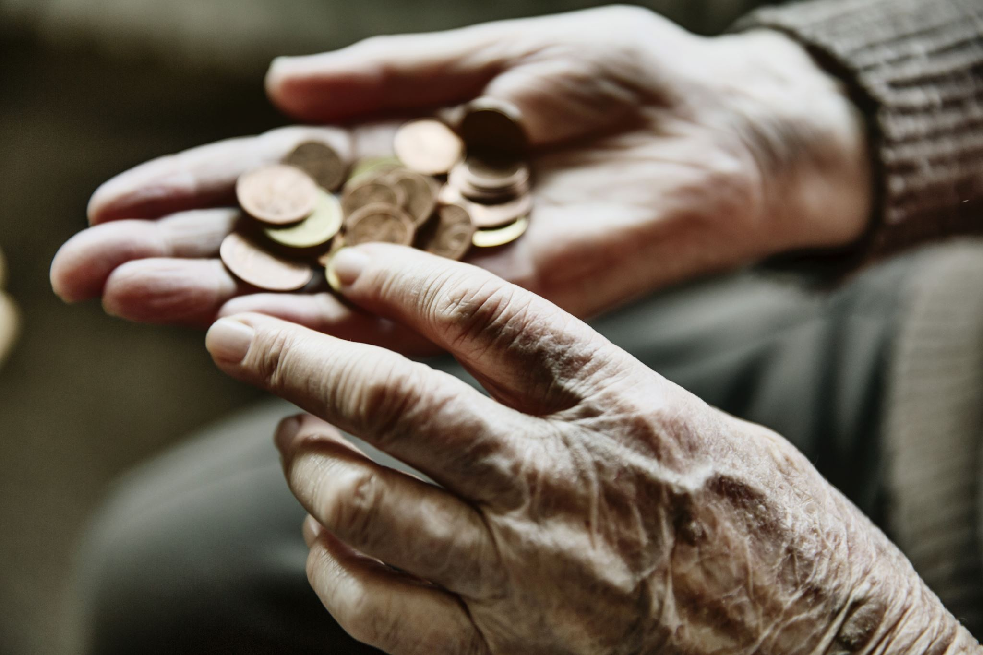
Agreement with distance, period of time, sum of money…
Use a singular verb with distances, period of time, sum of money, etc., when considered as a unit.
Examples: - Three miles is too far to walk. - Five years is the maximum sentence for that offense. - Ten dollars is a high price to pay.

Slide 13
Agreement with Collective Nouns
Some collective nouns, such as family, couple, staff, audience, etc., may take either a singular or a plural verb, depending on their use in the sentence.
Examples:
Mr. Kamlesh is our administrative staff.
The staff of ABES also need to learn the skills of communication.

Slide 14
Agreement with words that indicate portions
With words that indicate portions—a lot, a majority, some, all, etc. we are guided by the noun after of. If the noun after of is singular, use a singular verb. If it is plural, use a plural verb.
Examples: A lot of the pie has disappeared. A lot of the pies have disappeared. A third of the city is unemployed. A third of the people are unemployed. All of the pie is gone. All of the pies are gone.

Slide 15
Prefixes and Suffixes

Slide 16
Suffixes
Suffixes are added to the end of a main word. This often changes the word to a different part of speech. For example, a verb to an adjective.
Harmless
Restful
Childish
Likeable

Slide 17

Some suffixes and prefixes are part of our living language in that people regularly use them to create new words for modern products, concepts or situations.
For example, email. The prefix e stands for electronic and so we see a growing number of internet related words being formed such as e–book and e-commerce.
It is helpful to know the meanings of the prefixes and suffixes to then
understand the meaning of words.

Slide 18
Prefixes
Prefixes are added to the beginning of a word to make a new word with a different meaning. For example:
Unhappy
Illegal
Impossible
Multicultural

Slide 19

A prefix is a group of letters placed before the root of a word.
For example, the word "unhappy" consists of the prefix "un-" which means
"not" combined with the root or stem word "happy"; the word "unhappy" means "not happy."

Slide 20
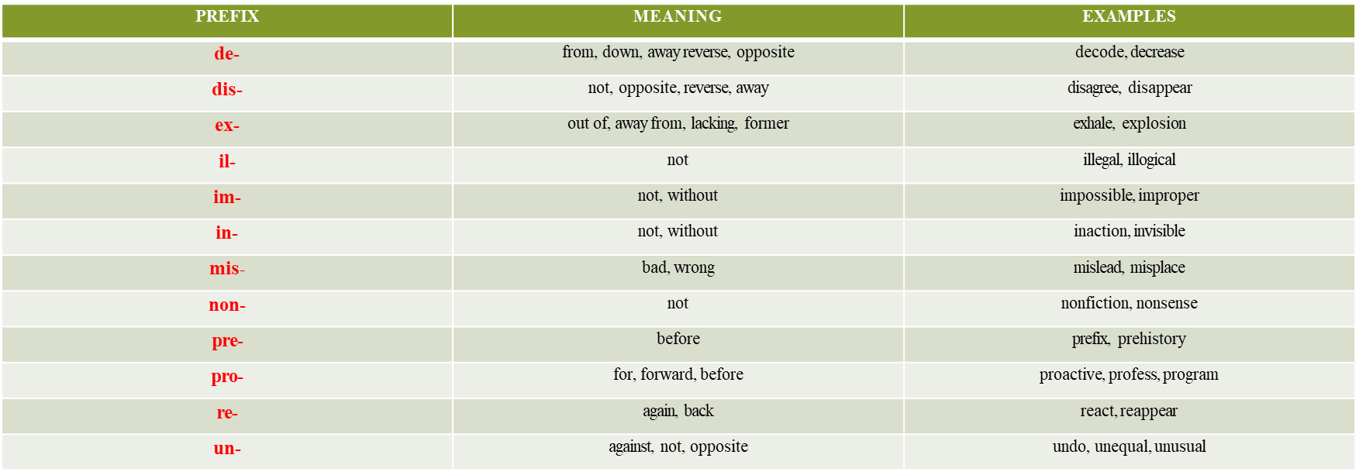
Prefixes

Slide 21
Suffixes
A suffix is a group of letters placed after the root of a word. For example, the word flavorless consists of the root word "flavor" combined with the suffix "-less" which means "without"; the word "flavorless" means "having no flavor."

Slide 22
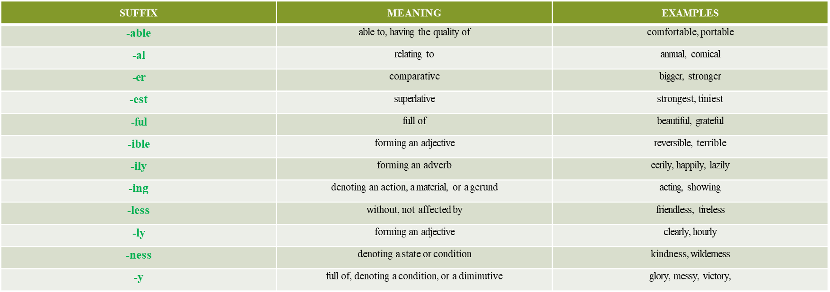
Suffixes

Slide 23

Remember that these lists of prefixes and suffixes do not cover all suffixes and prefixes. There are many others.

Slide 24
Synonyms
Synonyms are words with the same or similar meanings.
Words that are synonyms are said to
be synonymous, and the state of being a synonym is called synonymy.
The word comes from Ancient Greek syn (σύν) ("with") and onoma ( ὄνομα) ("name").
Synonyms can be any part of speech (such as nouns, verbs, adjectives, adverbs or prepositions), as long as both words are the same part of speech.

Slide 25

Here are more examples of English synonyms:
verb
"buy" and "purchase“
adjective
"big" and "large“
adverb
"quickly" and "speedily“
preposition
"on" and "upon"

Slide 26
Note that synonyms are defined with respect to certain senses of words; for instance, pupil is not synonymous with student.
Likewise, he expired means the same as he died, yet my passport has expired cannot be replaced by my passport has died.

Slide 27

Examples:
Beautiful: Attractive, Pretty, Lovely, Stunning
Fair: Just, Objective, Impartial, Unbiased
Funny: Humorous, Comical, Hilarious, Hysterical
Happy: Content, Joyful, Mirthful, Upbeat
Hardworking: Diligent, Determined, Industrious, Enterprising
Honest: Honourable, Fair, Sincere, Trustworthy
Intelligent: Smart, Bright, Brilliant, Sharp
Introverted: Shy, Bashful, Quiet, Withdrawn
Kind: Thoughtful, Considerate, Amiable, Gracious

Slide 28
 thrilled -excited
 melancholy - sad
 scream - yell
 huge - gigantic
 small - tiny
 skilled - talented
 novice - rookie
 often - frequently
 start - begin
 ridiculous - absurd
 help - aid
 fight - argue
 war - battle
 offbeat - unconventional
 winner - champion
 moist - damp
 fall - autumn
 strange - odd
 stinky - smelly

Slide 29
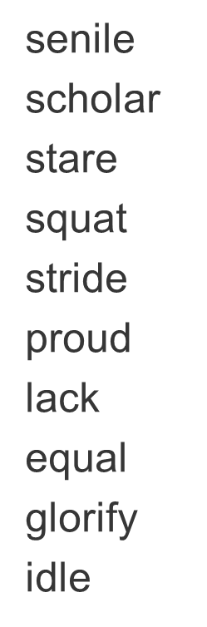
Which word in each series of words is not a synonym for the others?
Youthful
Student
Look
Rest
Sit
Kind
Fortune
Legal
Praise
Capable
juvenile author believe relax stroll caring luck lawful invite able

Slide 30
ANTONYM
AN·TO·NYM
a word opposite in meaning to another. Fast is an antonym of slow.
Categories Of Antonym
Graded antonyms deal with levels of the meaning of the words, like if something is not “good”, is may still not be “bad.”

Slide 31

Examples:
 Young and old
 Happy and sad
 Hard and soft
 Last and first
 Foolish and wise
 Fast and slow
 Warm and cool
 Wide and narrow
 Abundant and scarce
 Joy and grief
 Dark and light
 Dangerous and safe
 Clever and foolish

Slide 32
Complementary antonyms have a relationship where there is no middle ground. There are only two possibilities, either one or the other.
Examples include:
 Man and woman
 Push and pull
 Dead and alive
 Off and on
 Day and night
 Absent and present
 Exit and entrance
 Sink or float
 True or false
 Pass and fail
 Former and latter

Slide 33
Relational antonyms are sometimes considered a subcategory of complementary antonyms. With these pairs, for there to be a relationship, both must exist.
Examples are:
 Husband and wife
 Doctor and patient
 Buy and sell
 Predator and prey
 Above and below
 Give and receive
 Teach and learn
 Instructor and pupil
 Servant and master
 Borrow and lend
 Come and go

Slide 34
Word Formation
Word
“Word is a unit of a language which the natives can identify.”
or
“Words are blocks which form a sentence”
Basic Word:
“The words which have not been developed or derived from any other word are known as root, basic or primary words”. For example, White, tree, pain, boy, etc.

Slide 35
Types of word
Lexical Word
Functional Word

Slide 36
Lexical Word
A lexical item (lexical word) is what we normally recognize as "the ordinary word." A lexical item can also be a part of a word or a chain of words. Lexical items are the basic building blocks of a language's vocabulary (its lexicon, in other words).(All the Nouns, Verbs & Adjectives are lexical word)
cat (single word)
traffic light (words together meaning one thing)
take care of (a verbal phrase)
by the way (a chain of words)
it's raining cats and dogs (an idiomatic phrase)

Slide 37
Functional word
A grammatical word (a.k.a. function word) is a word that in itself has either (1) little or no actual meaning (lexical meaning) or (2) ambiguous or uncertain meaning, BUT functions to indicate grammatical relationships with other words in a sentence. The usual grammatical words are:-
auxiliaries (am, are, be, do, got, is, have, etc)
conjunctions (and, although, or, that, when, while, etc)
determiners (a, either, more, much, neither, my, that, the, etc)
particles (as, no, nor, not, etc)
prepositions (at, between, in, of, without, etc)
pronouns (I, you, he, she, it, we, they, anybody, one, etc)

Slide 38
Types of Word Formation Processes
Compounding
Derivation
Affixation
Blending
Clipping
Acronyms

Slide 39
Compounding
Compounding forms a word out of two or more root words. The words are called compounds or compound words.
mailman (composed of free root mail and free root man) mail carrier dog-house fireplace fireplug (a regional word for 'fire hydrant') fire hydrant dry run cupcake cup holder email e-ticket

Slide 40
Rhyming compounds
Rhyming compounds (subtype of compounds) These words are compounded from two rhyming words.
lovey-dovey chiller-killer
higgledy-piggledy tootsie-wootsie
bunnie-wunnie Henny Penny snuggly-wuggly Georgie Porgie Piggie-Wiggie

Slide 41
Derivation
Derivation is the creation of words by modification of a root without the addition of other roots. Often the effect is a change in part of speech.
Affixation (Subtype of Derivation) The most common type of derivation is the addition of one or more affixes to a root, as in the word derivation itself. This process is called affixation, a term which covers both prefixation and suffixation.

Slide 42
Blending
Blending is one of the most beloved of word formation processes in English. It is especially creative in that speakers take two words and merge them based on sound structure . The resulting words are called blends.
usually in word formation we combine roots or affixes along their edges:
mockumentary (mock and documentary)
mocktail (mock and cocktail) 'cocktail with no alcohol' splog (spam and blog) 'fake blog designed to attract hits and raise Google-ranking' Britpoperati (Britpop and literati) 'those knowledgable about current British pop music

Slide 43
Clipping
Clipping is a type of abbreviation of a word in which one part is 'clipped' off the rest, and the remaining word now means essentially the same thing as what the whole word means or meant. For example, the word rifle is a fairly modern clipping of an earlier compound rifle gun, meaning a gun with a rifled barrel. (Rifled means having a spiral groove causing the bullet to spin, and thus making it more accurate.) Another clipping is burger, formed by clipping off the beginning of the word hamburger. (This clipping could only come about once hamburg+er was reanalyzed as ham+burger.)

Slide 44
Acronyms
Acronyms are formed by taking the initial letters of a phrase and making a word out of it.
US or U.S., USA or U.S.A. (United States) UN or U.N. (United Nations) IMF (International Monetary Fund)

Slide 45
Homophones
“Words with same sound (pronunciation) but different meaning and spelling are known as Homophones”.
Air – (difference in atmospheric pressure) air is hot. Heir – is the heir to the throne.
Dear – is dear to me. Deer – deer is a beautiful animal.
Sea – the red sea. See – see the sky. the game.
Loose – shirt is loose. Lose – don’t lose

Slide 46
Homonyms
“Words with same sound (pronunciation) and spelling but different meanings.
Homonyms”.
Row – line Soil – make dirty
Row – boat propelling
Bank – side of river beam - a line of light
Bank – financial institution beam – a long piece of wood or metal
Coach – sports trainer
Coach – Large carriage

Slide 47
Books Prescribed
English Grammar & Usage, R.P.Sinha, Oxford University Press, New Delhi, 2005.
English Grammar & Composition, Wren & Martin S.Chand & Co Ltd, New Delhi, 2009.
Technical Communication, (Second Ed.); O.U.P., Meenakshi Raman & S.Sharma New Delhi, 2011

Slide 48

THANKS

